Slide 1

Simple, Fast Malicious Multiparty Private Set Intersection
Ofri Nevo、Ni Trieu、Avishay Yanai
2021 CCS
汇报人：赵偲琦

Slide 2
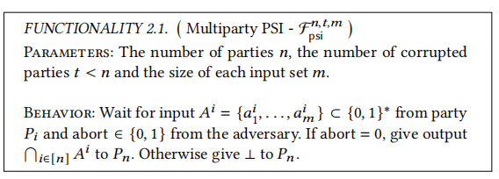

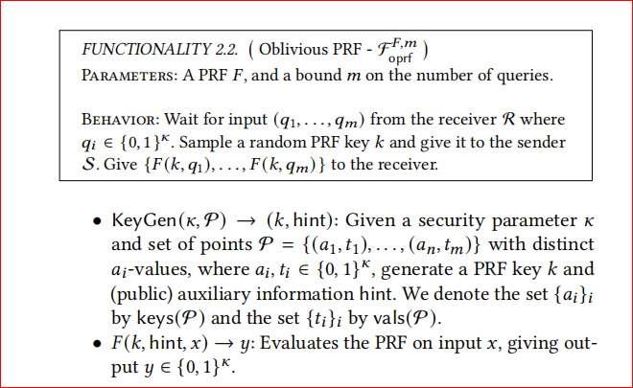




预备工作
A¹
A³
$$∩$$
P₁
P₃
A²
P₂
k
OPRF
S
R

Slide 3
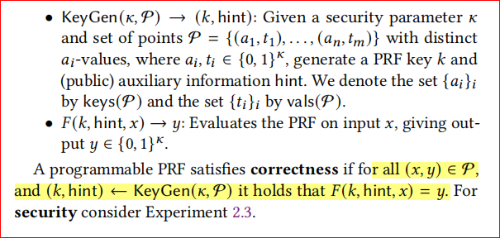
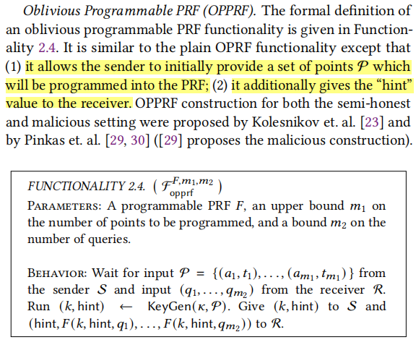




预备工作
PPRF：可编程PRF
对P进行了编程。输入的点的集合P提前经过了处理
OPPRF
(run KeyGen)
S
R

Slide 4
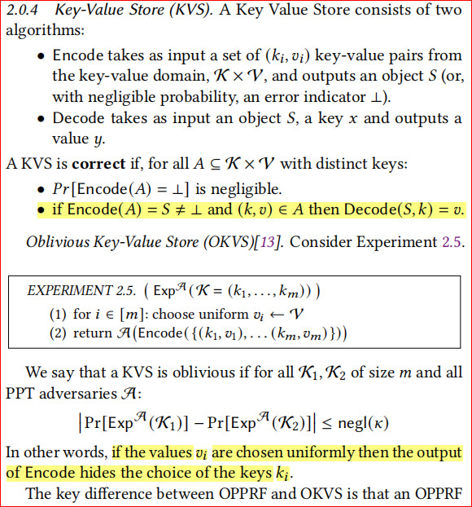
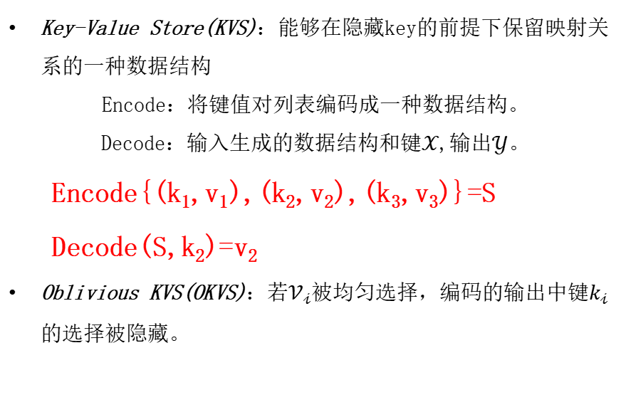
预备工作
Key-Value Store(KVS)：能够在隐藏key的前提下保留映射关系的一种数据结构
Encode：将键值对列表编码成一种数据结构。
Decode：输入生成的数据结构和键$𝒳$,输出$𝒴$。
Encode{(k₁,v₁),(k₂,v₂),(k₃,v₃)}=S
Decode(S,k₂)=v₂
Oblivious KVS(OKVS)：若$𝒱_{𝒾}$被均匀选择，编码的输出中键$k_{𝒾}$的选择被隐藏。

Slide 5
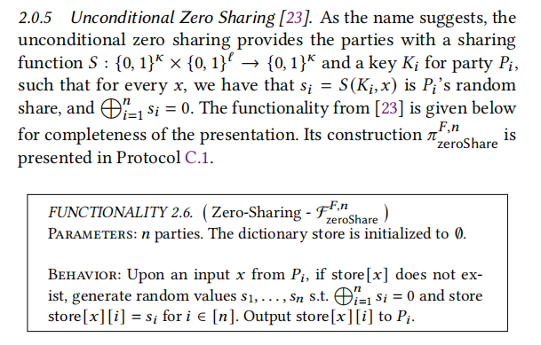

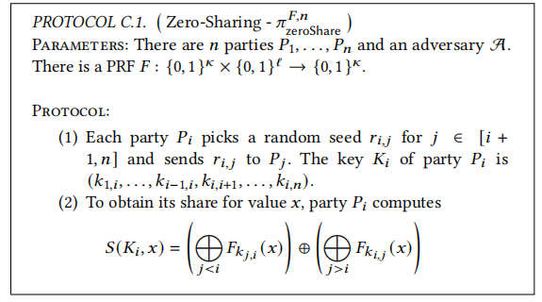







预备工作
p₁
$$K_{1}=(K_{1,2},K_{1,3})$$
$$s_{1}=S(K_{1},x)=F_{K_{1,2}}(x)⨁F_{K_{1,3}}(x)$$
$$K_{1,2}$$
$$K_{1,3}$$
$$K_{2,3}$$
p₂
$K_{2}$=$(K_{1,2},K_{2,3})$
$K_{3}$=$(K_{1,3},K_{2,3})$
p₃

Slide 6
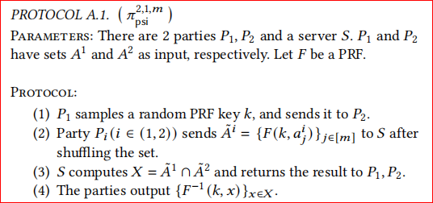




预备工作
A¹
$$K$$
A²
p₁
p₂
$${\tilde{A^{1}}=\{F(k,a_{j}^{1})\}}_{j∈[m]}$$
$${\tilde{A^{2}}=\{F(k,a_{j}^{2})\}}_{j∈[m]}$$
X
X
K
[23] Vladimir Kolesnikov, Naor Matania, Benny Pinkas, Mike Rosulek, and Ni Trieu.
Practical multi-party private set intersection from symmetric-key techniques. In
CCS, 2017.
S

Slide 7
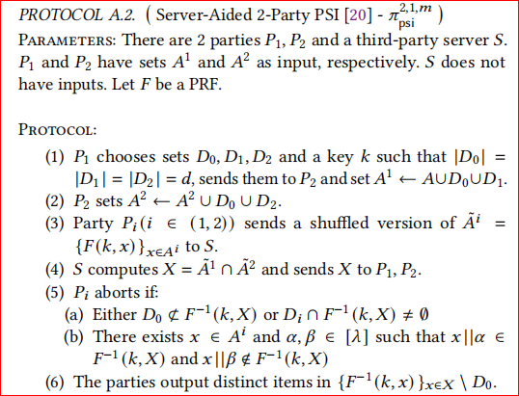




预备工作
A¹
A²
p₁
p₂
$${\tilde{A^{1}}=\{F(k,a_{j}^{1})\}}_{j∈[m]}$$
$${\tilde{A^{2}}=\{F(k,a_{j}^{2})\}}_{j∈[m]}$$
X
X
[20] Seny Kamara, Payman Mohassel, Mariana Raykova, and Seyed Saeed Sadeghian.
Scaling private set intersection to billion-element sets. In Financial Cryptography
and Data Security - 18th International Conference, FC 2014, Christ Church, Barbados,
March 3-7, 2014, Revised Selected Papers, pages 195–215, 2014.
K
S

Slide 8

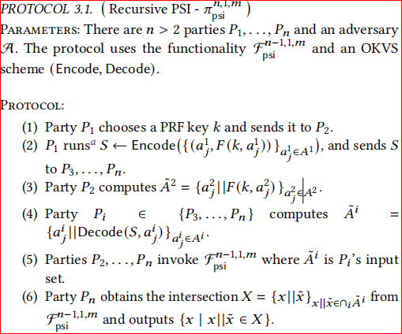
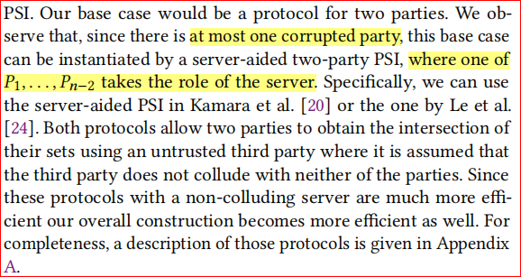


PSI WITH NO COLLUSION
{a¹,b¹}
P₁
K
P₂
P₃
P₄
{a²,c²}
S
S
{a³,b³}
将n方求交问题转化为n-1方求交
{a⁴,b⁴}
$$\tilde{A^{3}}=\{a^{3}||F(k,a^{1}),b^{3}||随机数\}$$
$$\tilde{A^{4}}=\{a^{4}||F(k,a^{1}),b^{4}||随机数\}$$
问题：n-1方如何使用server-aided two-party PSI协议进行递归求交

Slide 9
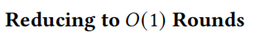
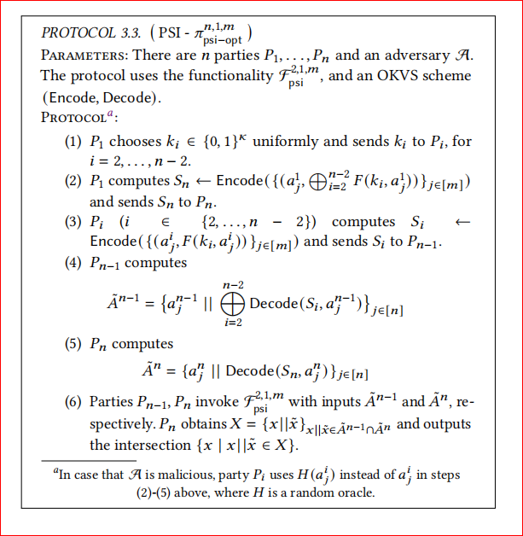

PSI WITH NO COLLUSION
可抵抗不诚实输入
K₂
{a¹,b¹}
P₁
P₂ {a²,c²}
P₃ {a³,d³}
K₃
S₅
S_{i}
$$F_{psi}^{2,1,m}$$
{a⁵,f⁵}
P₅
P₄
{a⁴,e⁴}
将n方求交问题转化为2方求交

Slide 10
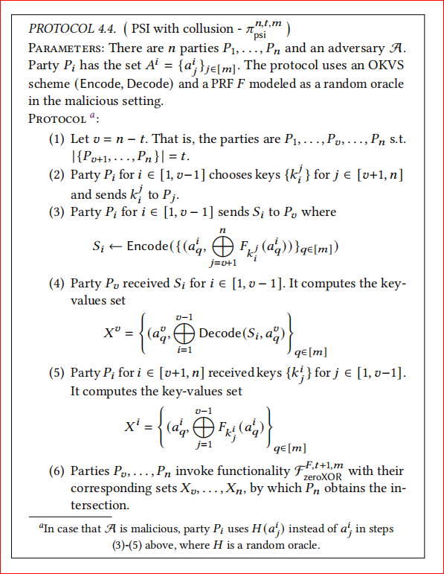




PSI WITH ARBITRARY COLLUSION
P₁
P₂
$$K_{1}^{4}$$
P₄
P₅
{a¹,b¹}
{a⁴,d⁴}
$$K_{1}^{5}$$
$$K_{2}^{4}$$
{a²,c²}
{a⁵,e⁵}
$$K_{2}^{5}$$
S_{i}
可抵抗不诚实输入；特定t+1方串通会造成信息泄露
P₃
{a³,f³}
$$Decode(S_{1},a^{3})⨁Decode(S_{2},a^{3})=F_{K_{1}^{4}}(a^{3})⨁F_{K_{1}^{5}}(a^{3})⨁F_{K_{2}^{4}}(a^{3})⨁F_{K_{2}^{5}}(a^{3})$$

Slide 11
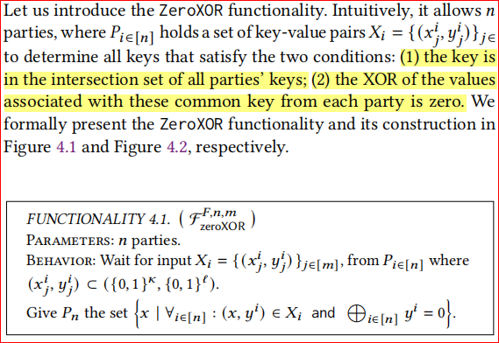
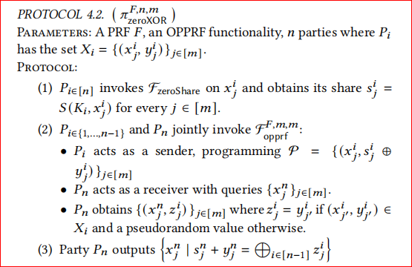

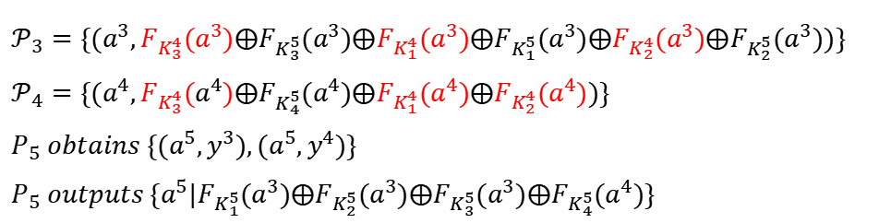
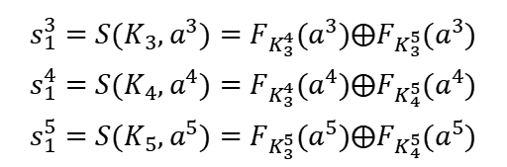




ZeroXOR
P₃
{a³,f³}
P₄
{a⁴,d⁴}
P₅
{a⁵,e⁵}
$$K_{3}=(K_{3,4},K_{3,5})$$
$$K_{4}=(K_{3,4},K_{4,5})$$
$$K_{5}=(K_{3,5},K_{4,5})$$
$$s_{1}^{3}=S(K_{3},a^{3})=F_{K_{3}^{4}}(a^{3})⨁F_{K_{3}^{5}}(a^{3})$$
$$s_{1}^{4}=S(K_{4},a^{4})=F_{K_{3}^{4}}(a^{4})⨁F_{K_{4}^{5}}(a^{4})$$
$$s_{1}^{5}=S(K_{5},a^{5})=F_{K_{3}^{5}}(a^{5})⨁F_{K_{4}^{5}}(a^{5})$$
OPPRF
{a,e}
$$𝒫_{3}、𝒫_{4}$$
S
R
$$𝒫_{3}=\{(a^{3},F_{K_{3}^{4}}(a^{3})⨁F_{K_{3}^{5}}(a^{3})⨁F_{K_{1}^{4}}(a^{3})⨁F_{K_{1}^{5}}(a^{3}){⨁F}_{K_{2}^{4}}(a^{3})⨁F_{K_{2}^{5}}(a^{3}))\}$$
$$𝒫_{4}=\{(a^{4},F_{K_{3}^{4}}(a^{4})⨁F_{K_{4}^{5}}(a^{4})⨁F_{K_{1}^{4}}(a^{4})⨁F_{K_{2}^{4}}(a^{4}))\}$$
$$P_{5} obtains \{{(a}^{5},y^{3}),{(a}^{5},y^{4})\}$$
$$P_{5} outputs \{a^{5}|F_{K_{1}^{5}}(a^{3})⨁F_{K_{2}^{5}}(a^{3})⨁F_{K_{3}^{5}}(a^{3})⨁F_{K_{4}^{5}}(a^{4})\}$$

Slide 12


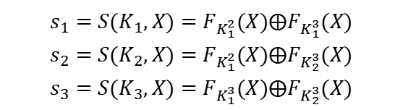

tools
OPPRF:
OPPRF
(run KeyGen)
S
R
Encode{(k₁,v₁),(k₂,v₂),(k₃,v₃)}=S
Decode(S,k₂)=v₂
OKVS:
P₁
{X}
P₂
{X}
P₃
{X}
zero sharing:
$$K_{1}=(K_{1,2},K_{1,3})$$
$$K_{2}=(K_{1,2},K_{2,3})$$
$$K_{3}=(K_{1,3},K_{2,3})$$
$$s_{1}=S(K_{1},X)=F_{K_{1}^{2}}(X)⨁F_{K_{1}^{3}}(X)$$
$$s_{2}=S(K_{2},X)=F_{K_{1}^{2}}(X)⨁F_{K_{2}^{3}}(X)$$
$$s_{3}=S(K_{3},X)=F_{K_{1}^{3}}(X)⨁F_{K_{2}^{3}}(X)$$

Slide 13
















[23]
半诚实设置下安全；不能抵抗恶意发送者（基于布谷鸟哈希实现的OPPRF中，恶意发送者会用非交集点代替交集点返回给接收者）；任意n-1方串通会造成信息泄露（得到全部密钥）
zero sharing +OPPRF
p₁
p₁
{$X$}
$P_{1}$=$\{(X^{1},s_{1}(X^{1})\}$
$$K_{1}=(K_{1,2},K_{1,3})$$
$$K_{1}^{’}=(K_{1,2},K_{1,3},K_{2,3})$$
$$X$$
$$s_{3}(X^{3})$$
$$X$$
$$s_{2}(X^{2})$$
$$X$$
$$s_{3}(X^{3})=F_{K_{1}^{3}}(X^{3})⨁F_{K_{2}^{3}}(X^{3})$$
OPPRF
OPPRF
OPPRF
$P_{3}$=$\{(X^{3},s_{3}(X^{3})\}$
{$X’$}
{$X$}
$P_{2}$=$\{(X^{2},s_{2}(X^{2})\}$
$P_{3}$=$\{(X^{3},s_{3}(X^{3})\}$
p₃
p₂
$$K_{2}=(K_{1,2},K_{2,3})$$
p₃
p₂
$$K_{3}=(K_{1,3},K_{2,3})$$

Slide 14


